Slide 1
RAILWAY RESERVATION SYSTEM

Slide 2
INTRODUCTION
PURPOSE:
To perform the online railway reservation system
The software includes the train search, train reservation and ticket cancellation.
Providing the details of the train
Printing the ticket

Slide 3
USER INTERFACE

Slide 4
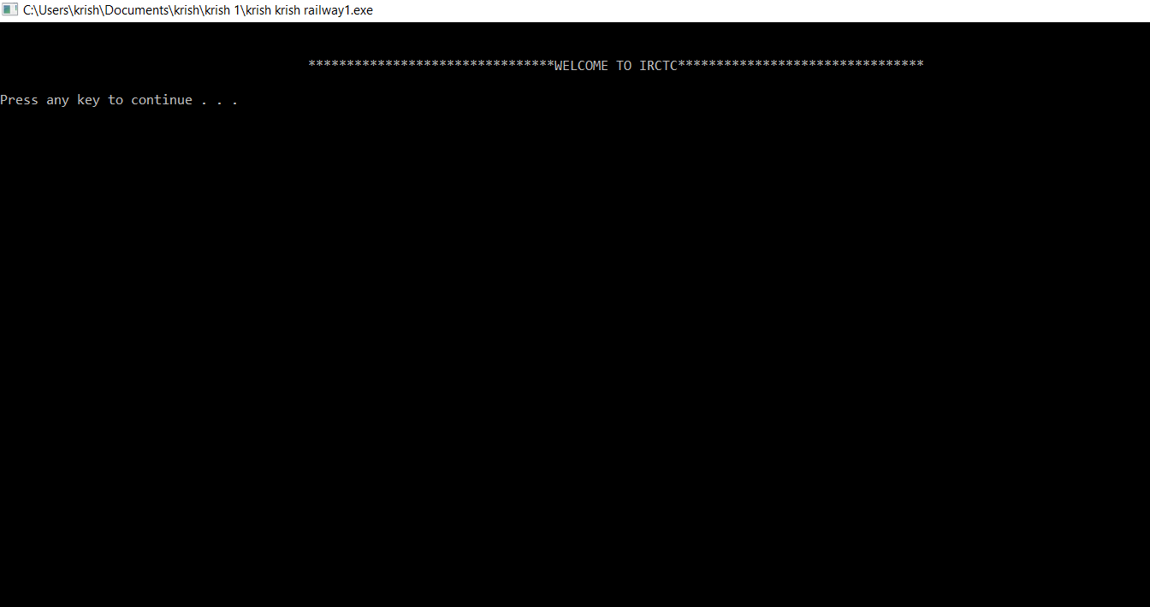
Home page

Slide 5
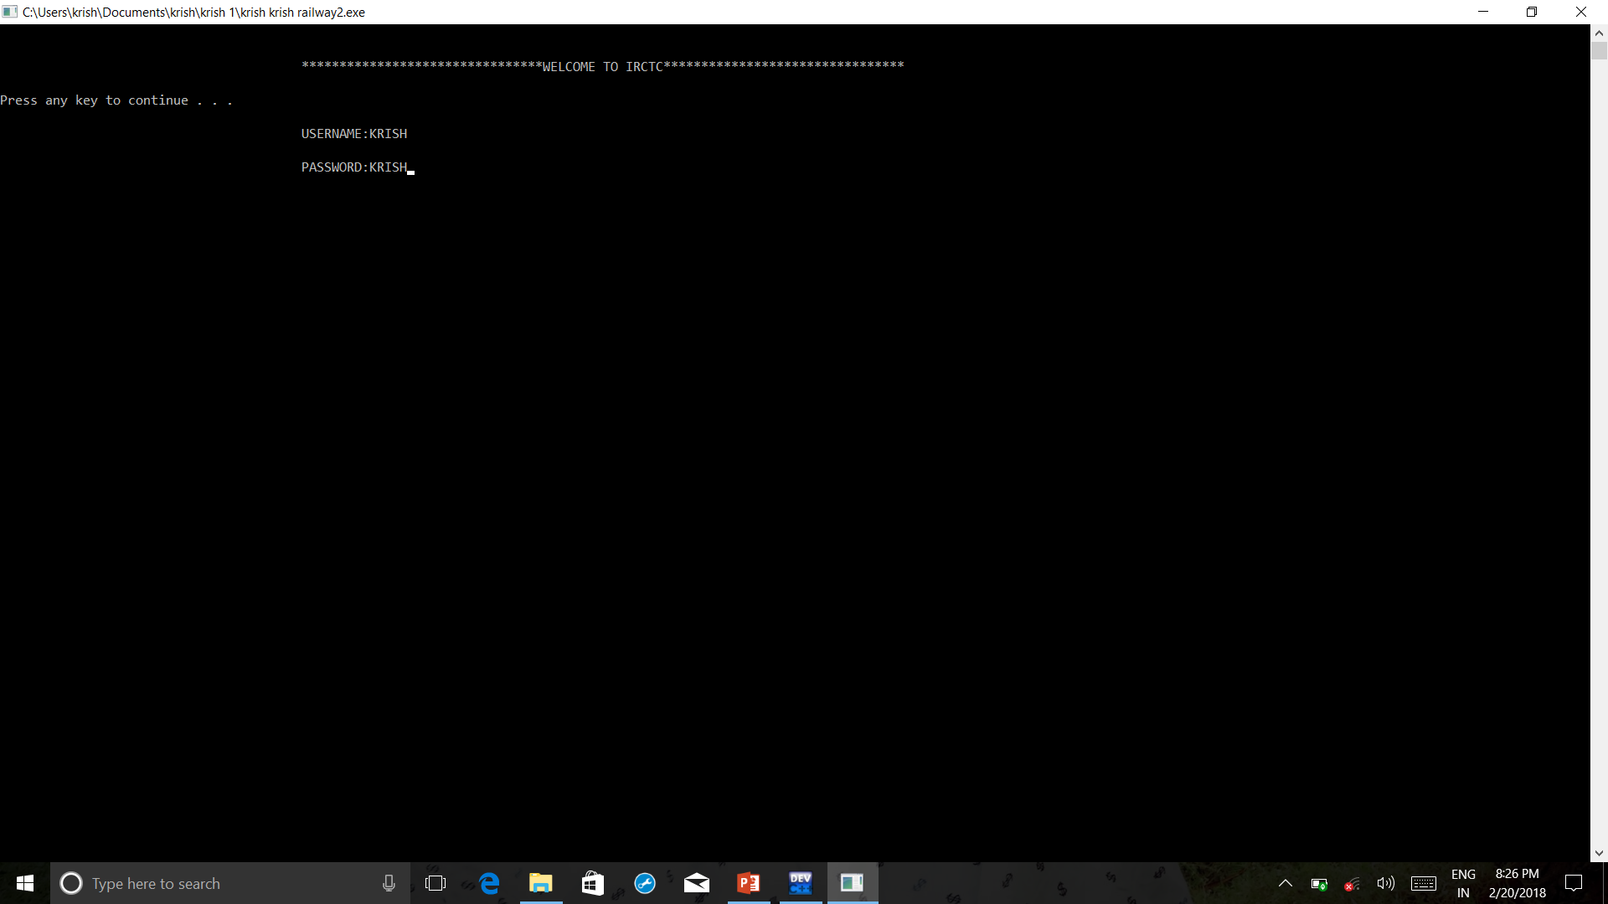
Login page for IRCTC

Slide 6
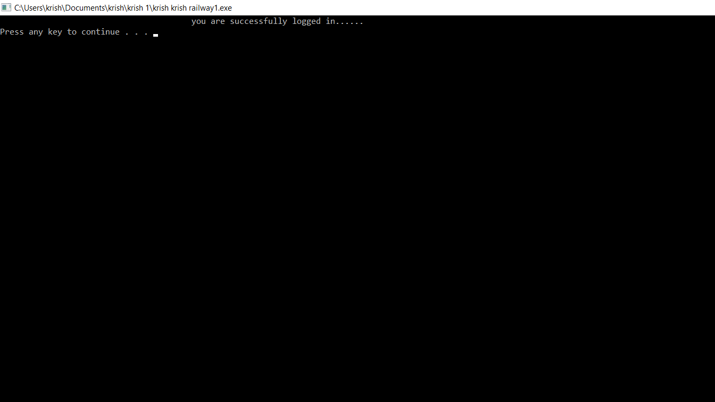
If you are successfully logged in

Slide 7
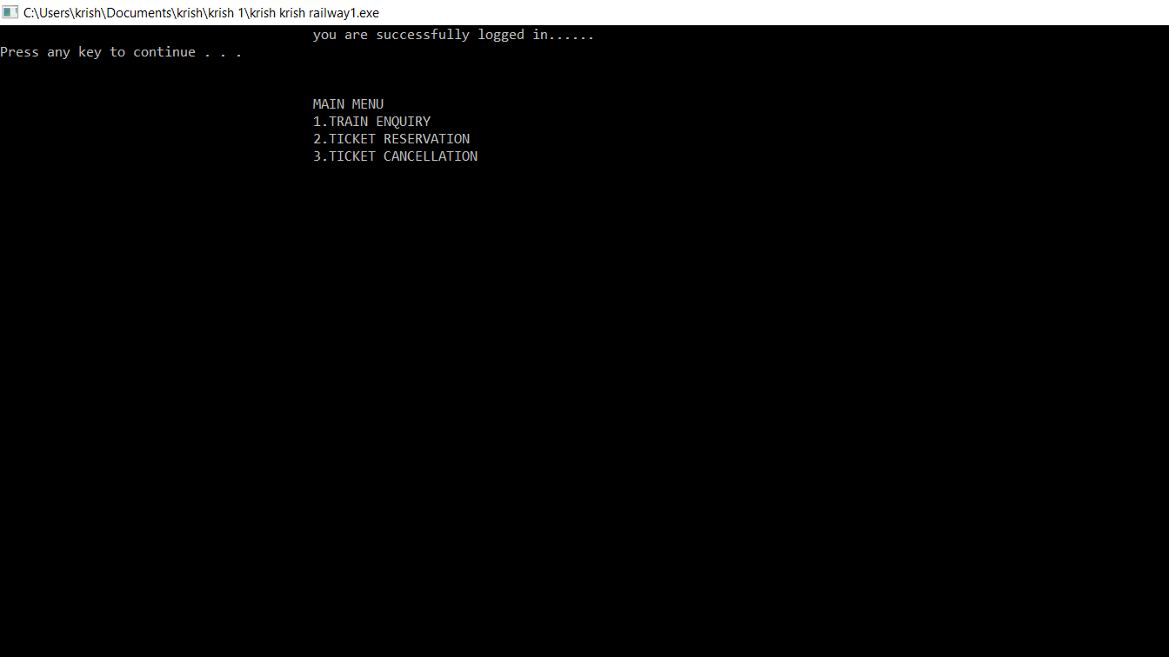
Main menu

Slide 8
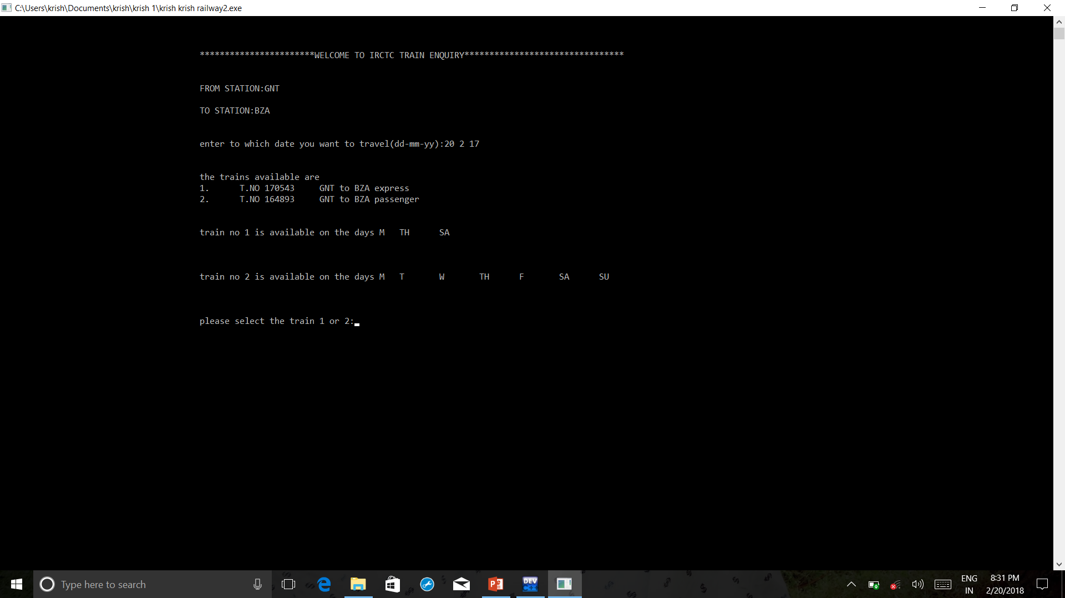
TRAIN ENQUIRY

Slide 9
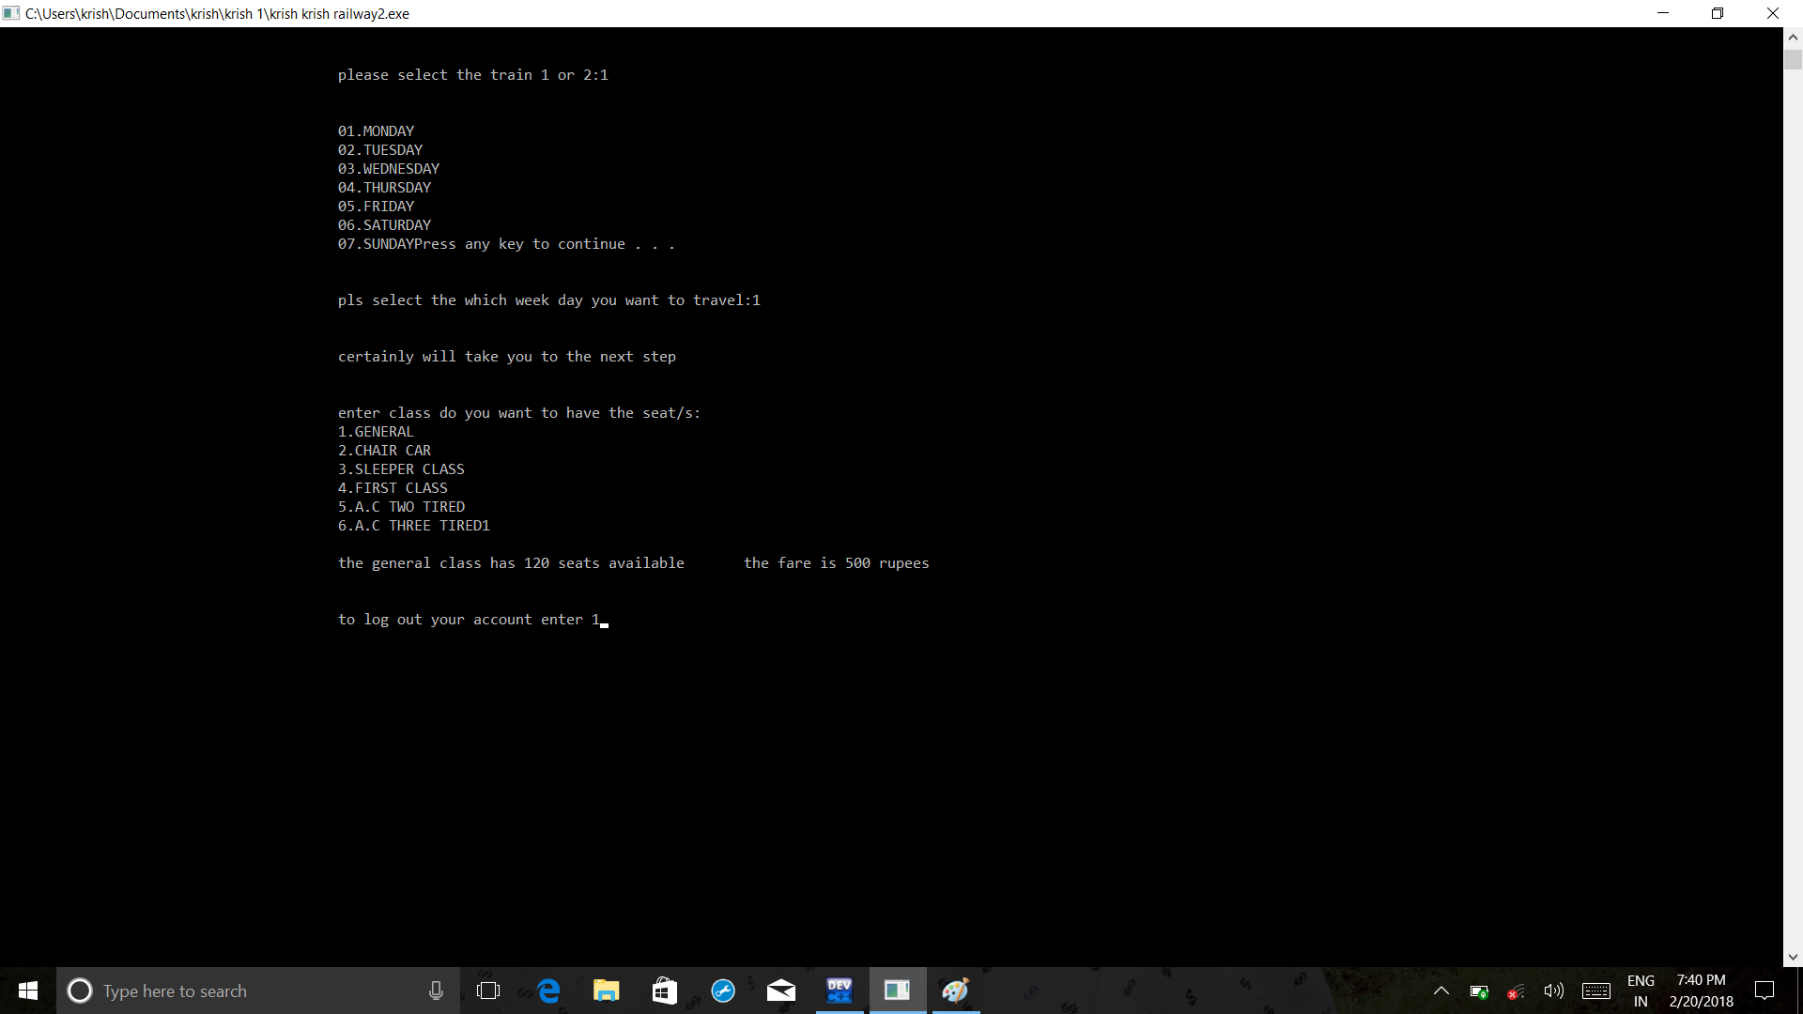
CONTD..

Slide 10
MENU

Slide 11
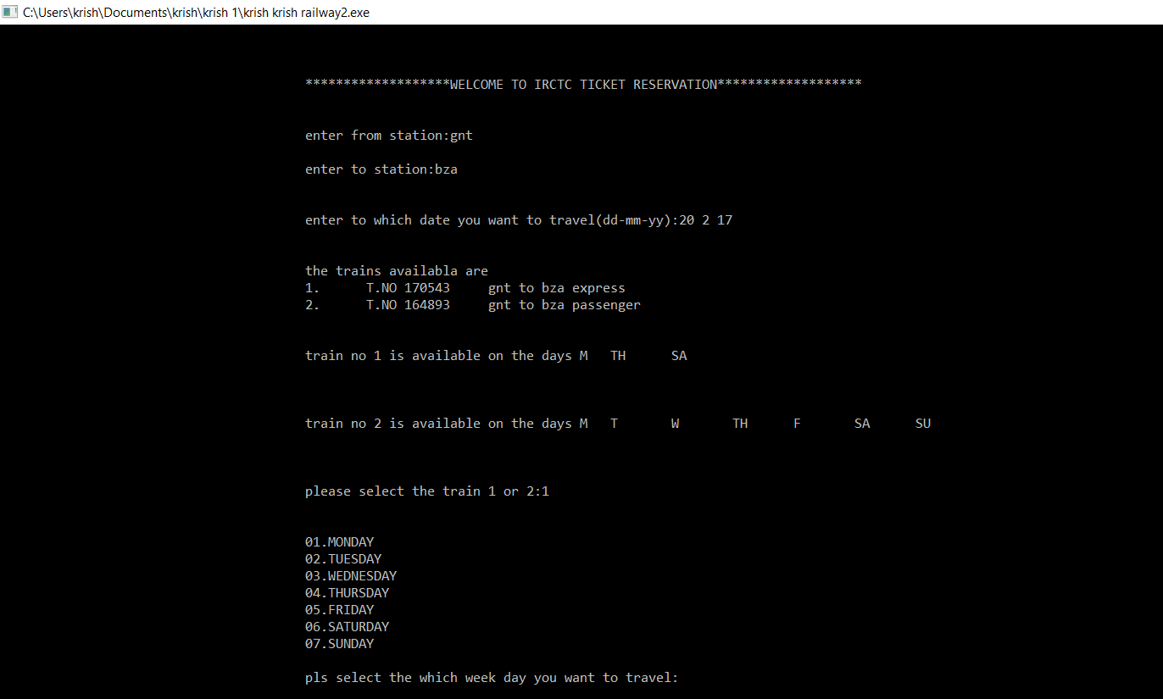
TICKET RESERVATION

Slide 12
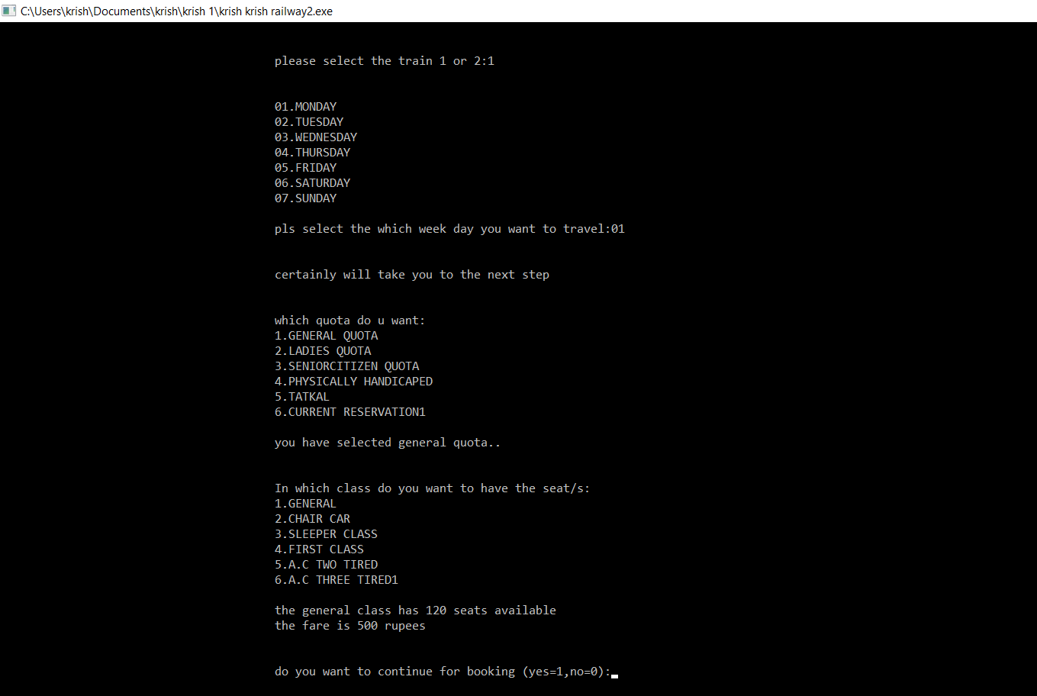
CONTD…

Slide 13
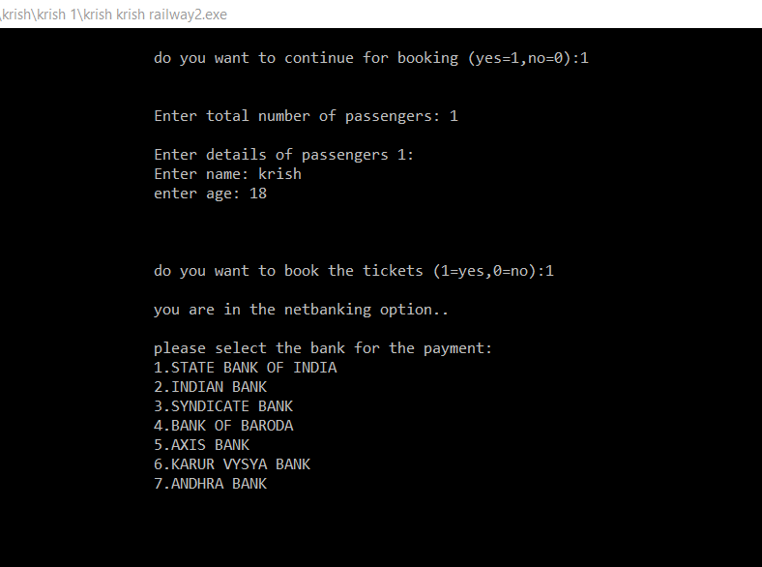
CONTD…

Slide 14
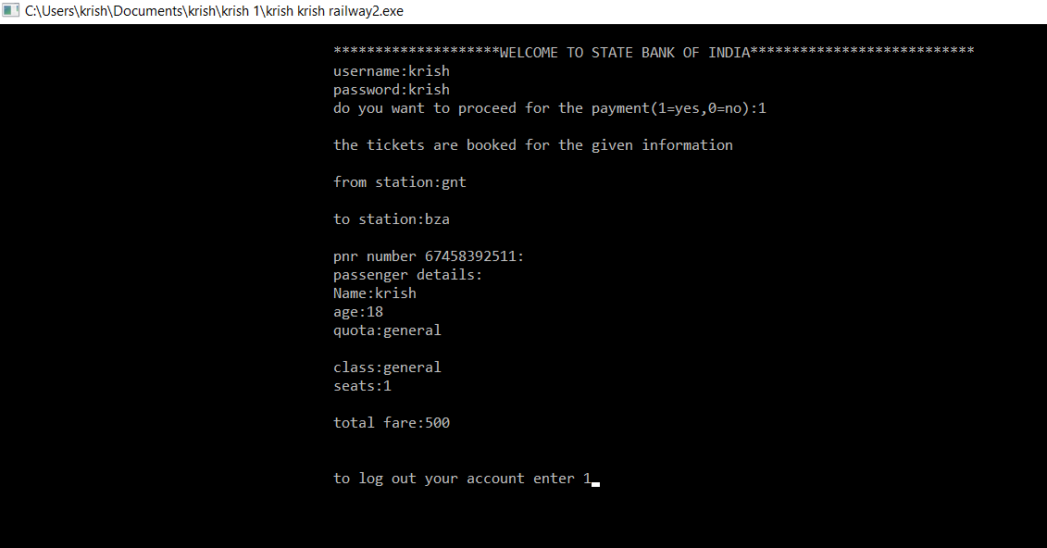
REDIRECTING TO THE BANK FOR PAYMENT

Slide 15
MENU

Slide 16
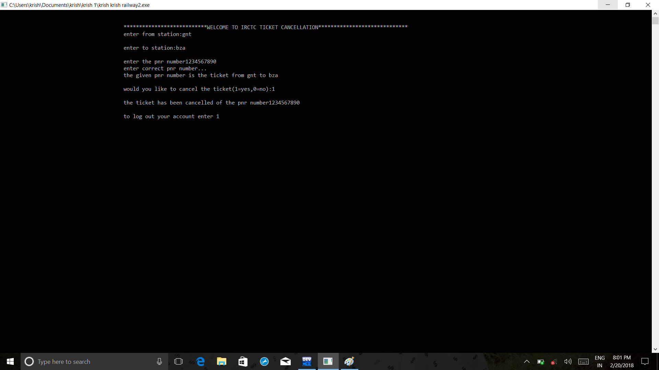
TICKET CANCELLATION

Slide 17
THANK YOU

